Slide 1
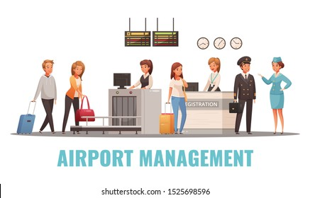
AIRPORT MANAGEMENT SYSTEM
Mahendrakar Charan(RA2011027020098)
Kalluri Gopi Kiran(RA2011027020076)
Para Chaitanya(RA2011027020083)

Slide 2

INTRODUCTION
This is an International Airport Database project consisting of developing entities and their respective attributes. This approach also includes writing and applying queries as required. After forming initial Entities with their attributes, we develop ER diagram for given entities in further phases.
Scheduling flights, managing different service-provided Airplanes with respect to their terminals, Bookings of flights, and details of passengers are the main aspects that are covered under this project. This database can handle different requests and provides an output based on the above entities. The results from this database are used by airport authorities for better decision-making.

Slide 3

ABSTRACT
The airport database management system consists of different airports with their available terminals. It keeps track of all the flights, their routes, and Arrival and departure times. it also keeps track of the passenger and their booking information. For each airport, there will be many terminals. each terminal is allowed to depart or arrive on the flights of some specific airlines. each airline might have many flights with different capacities. Passengers, personal information such as Passenger name, city, mobile number, and email address should be available. passenger gets the passenger id upon registering into the system. Only the registered passenger are allowed to book the tickets. The passenger can have the option to select the flight and route for booking the ticket. The arrivals and departures can also be tracked in the system for each flight. The airline services will have the Origin country and each airline will have an owner.

Slide 4

OBJECTIVE
The main objective of the project is to learn and implement a real-time application on a database for airport database management system. The project, concentrates on bookings, and tracking the flights . This Database will be a great solution for many functionalities in Airport.

Slide 5

PROPOSED SYSTEM
The purpose is to create an ongoing, constructive dialogue that consolidates airline views and supports informed decision-making through the review of airport investment plans, an assessment of operational and passenger impacts, and the analysis of costs and benefits.

Slide 6
MODULE DESCRIPTION

Slide 7
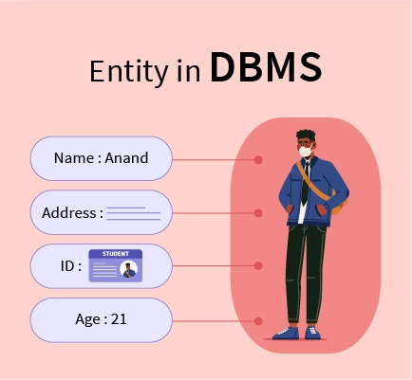
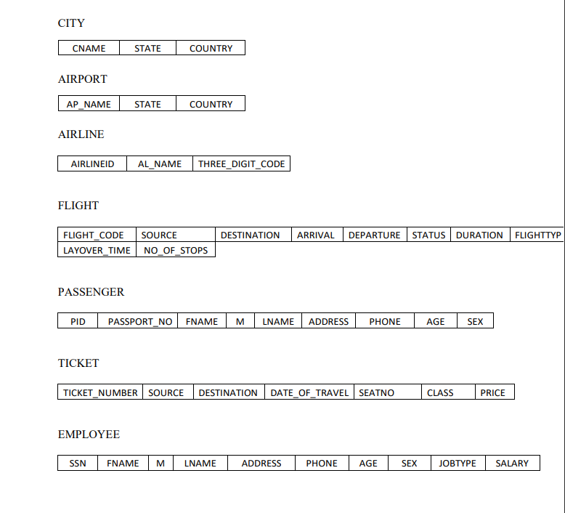
ENTITIES
In a database management system (DBMS), an entity is a piece of data that is stored in the database. An entity can be a person, place, thing, or even an event.

Slide 8
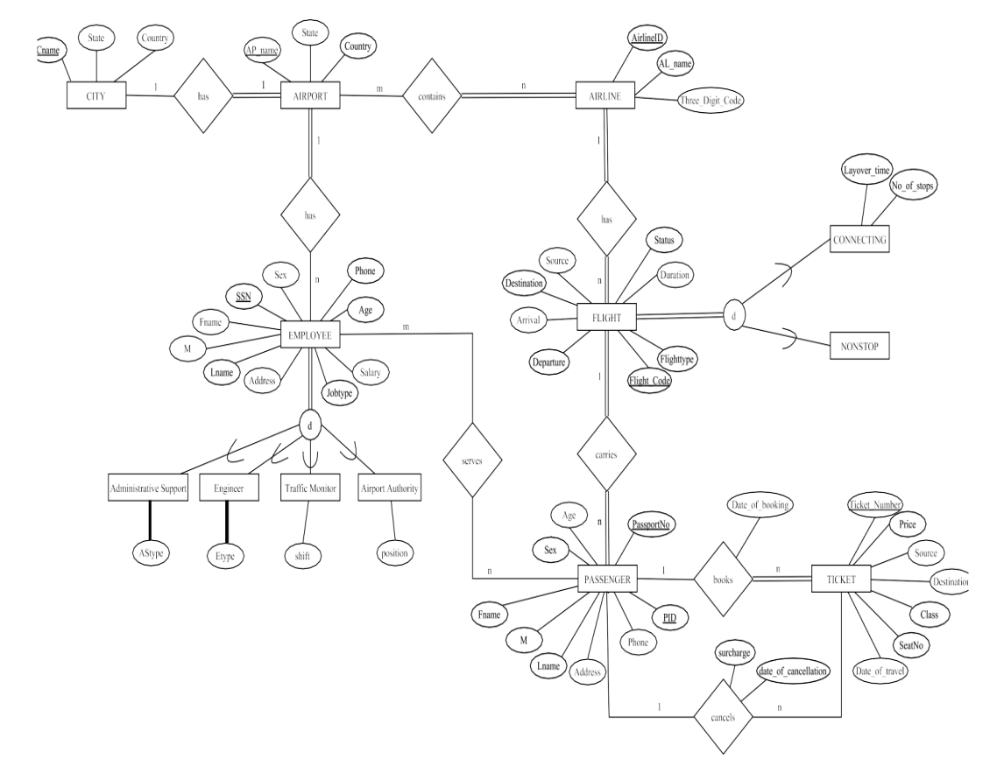
MAPPING ER DIAGRAM TO RELATIONAL SCHEMA

Slide 9
LITERATURE SURVEY
S.NO | TITLE | AUTHOR & YEAR
ACRP Report 16 | Guidebook for Managing Small Airports | (Grothaus et al. 2009)
ACRP Report 18 | Passenger Air Service Development Techniques | (Martin 2009)
ACRP Report 25 | Airport Passenger Terminal Planning and Design | (Landrum & Brown et al. 2010)
ACRP Synthesis 68 | Strategies for Maintaining Air Service | (Gordon and Galvan-Peterson 2015)

Slide 10
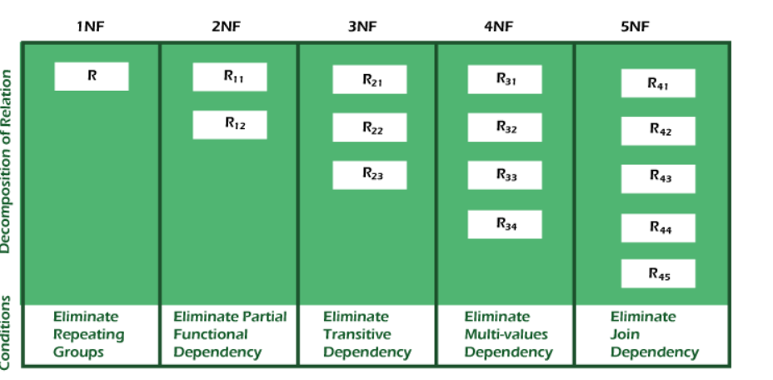
NORMALIZATION
Normalization is the process of organizing the data in the database.
Normalization is used to minimize the redundancy from a relation or set of relations. It also eliminates undesirable characteristics like Insertion, Update, and Deletion Anomalies.
Normalization divides the larger table into smaller ones and links them using relationships.
The normal form is used to reduce redundancy from the database table.

Slide 11
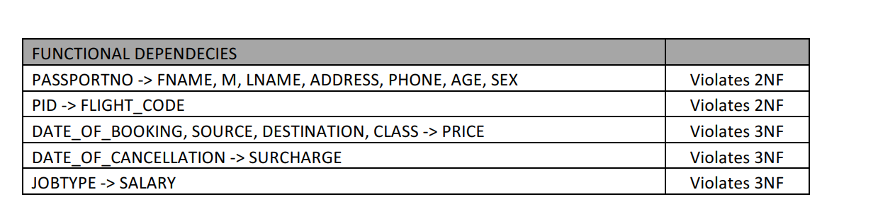
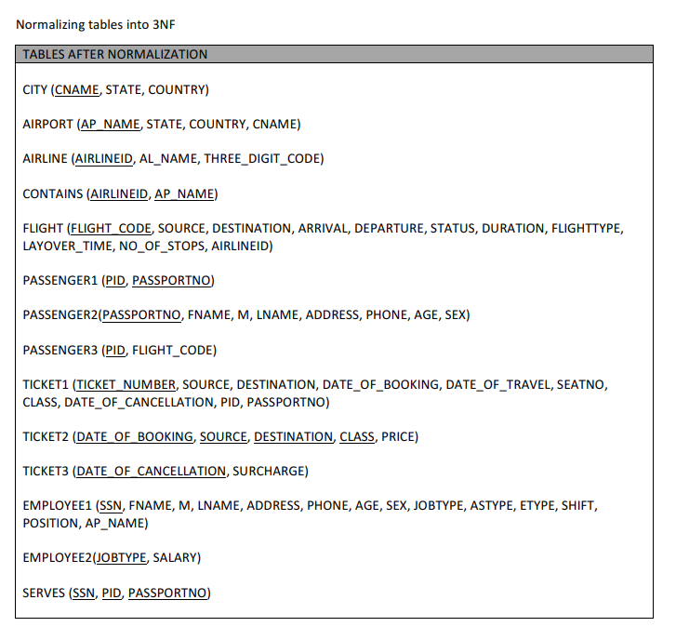

Slide 12
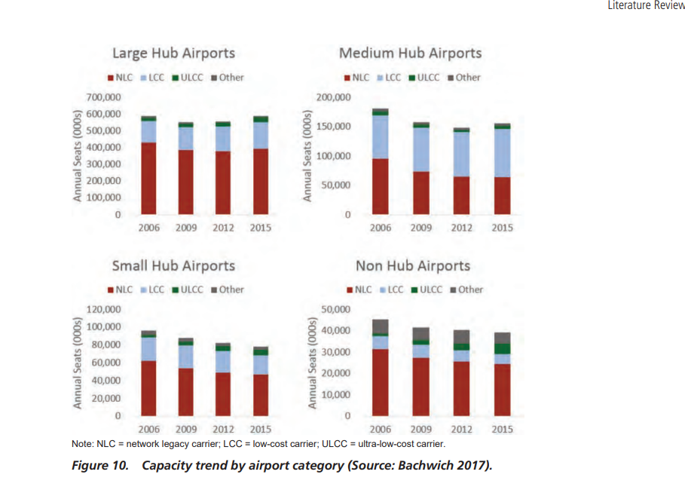
How Airports Plan for Changing Aircraft Capacity?

Slide 13
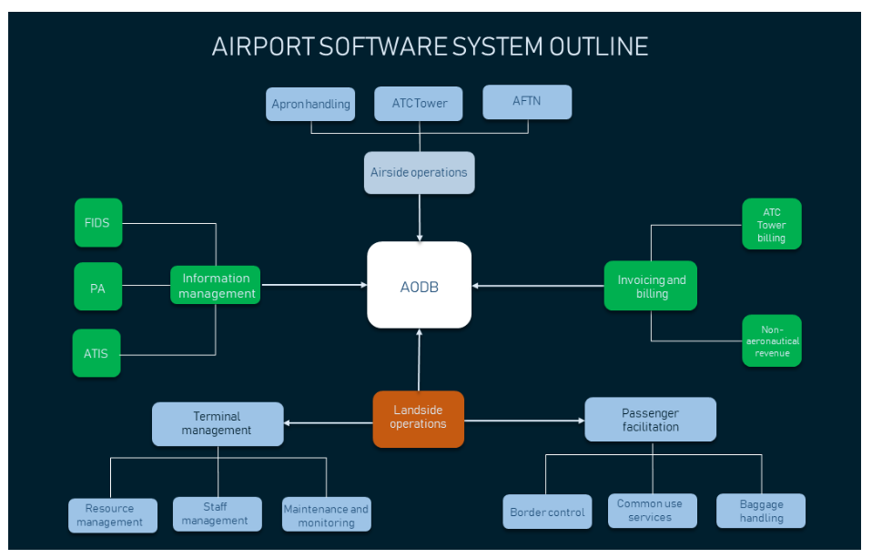
AIRPORT SOFTWARE SYSTEMS OUTLINE

Slide 14
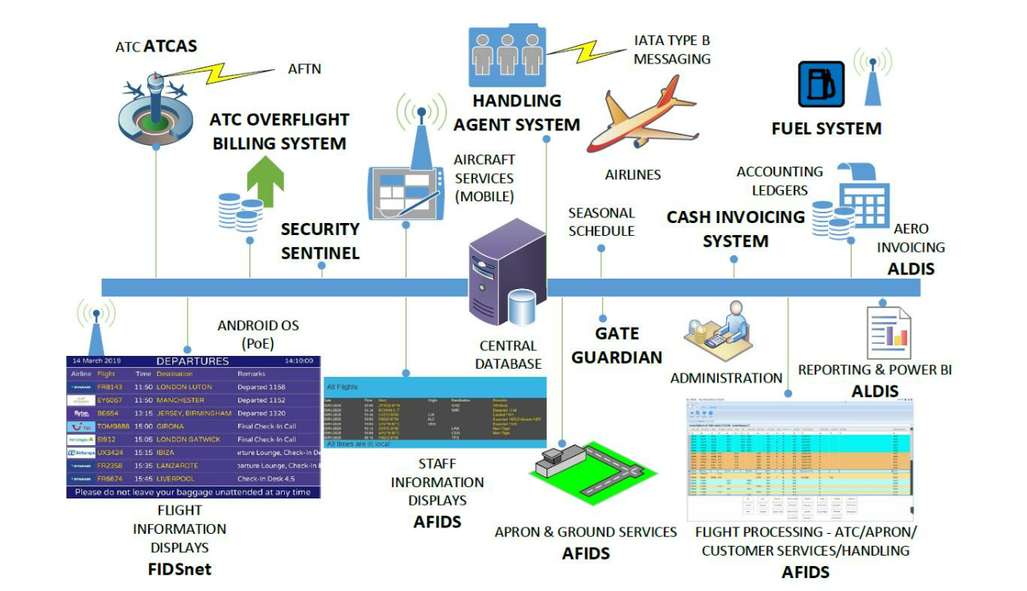
AIS Integrated Airport Management System

Slide 15
ALDIS – Airport Landing Dues Information System
ALDIS is an Airport Management System with the capability of Aeronautical Billing.
ALDIS functionality includes configuring multiple discounts and surcharges as well as commercial target incentives and the system has been successfully implemented in over thirty airports worldwide.
AFIDS – Airport Flight Information Display System

Slide 16
FUTURE ENHANCEMENT
Seamless passenger flow, up-to-date information, and air traffic management are the keys to successful airport functioning. Global technological development impacts airports, creating new opportunities and challenges. In the next three years, airport IT operations will focus on cloud solutions, business intelligence, and cybersecurity, according to Air Transport IT Insights 2019 by SITA. Let’s briefly look at the future of those trends:
Passenger self-service solutions:-As airports strive to reduce wait time, so they’re investing in various self-service solutions. These will include not only passenger check-in kiosks, automated boarding gates, baggage drop and smart tracking but also mobile integration of airport information systems

Slide 17
Artificial Intelligence and predictive analytics:-Airlines already use AI and data science in their operations. Almost 80 per cent of airports are using them in customer service too or plan to use them in the near future as virtual agents and chatbots for advertising, personalization, airport and flight status information, and brand perception improvement.
Cybersecurity:-Most of airports improve cybersecurity, by investing in staff education. With 79 per cent of airports investing in cybersecurity, the other priority fields for investment are telecommunications, network security, and threat intelligence

Slide 18
CONCLUSION
Developing a Database is never an easy task during the process of creating the database we’ve learned so many things like taking the real worlds objects into consideration and creating the entities and attributes, normalizing the entire schema and analyzing the functional dependencies and the most crucial part is to retrieve the data.
In conclusion for every front-end application we develop, there should be a concrete database model to represent the application. In our case “Airport Database System” will represent real-time anomalies.

Slide 19
REFERENCES
Airbus, Growing Horizons: Global Market Forecast 2017–2036, 2017. http://www.airbus.com.
Bachwich, A. R. U.S. Airline Business Models 2006–2015: Trends and Key Impacts. Massachusetts Institute
of Technology, 2017. https://dspace.mit.edu/bitstream/handle/1721.1/111264/1003292805-MIT.pdf?
sequence=1.
Bacon, T. U.S. Airline Consolidation: What Happens Next? EyeforTravel, Mar. 7, 2017. https://www.eyefortravel.
com/revenue-and-data-management/us-airline-consolidation-what-happens-next.
CAPA (Centre for Aviation). U.S. Airline Fleet Strategy and Finance Part 1: The Big 3 Take Differing Approaches
to Fleet Revamps, 2015. https://centreforaviation.com/insights/analysis/us-airline-fleet-strategy-andfinance-part-1-the-big-3-take-differing-approaches-to-fleet-revamps-242433.
Carlyle, E. America’s Fastest-Growing Cities 2016. Forbes, Mar. 8, 2016. https://www.forbes.com/sites/
erincarlyle/2016/03/08/mericas-fastest-growing-cities-2016/#7ea276811aac.
Carey, S. and J. Nicas. Airlines’ New Normal: More Seats, Fewer Flights. The Wall Street Journal, 2015.
https://www.wsj.com/articles/new-normal-for-airlines-more-seats-fewer-trips-1435874679.

